Slide 1

MACHINE LEARNING FOR PARTICLE IDENTIFICATION & DEEP GENERATIVE MODELS TOWARDS FAST SIMULATIONS FOR THE ALICE TRD AT CERN
Christiaan Gerhardus Viljoen
MSc Data Science - University of Cape Town

Slide 2
MACHINE LEARNING FOR PARTICLE IDENTIFICATION & DEEP GENERATIVE MODELS TOWARDS FAST SIMULATIONS FOR THE ALICE TRD AT CERN
Christiaan Gerhardus Viljoen
MSc Data Science - University of Cape Town

Slide 3








MACHINE LEARNING FOR PARTICLE IDENTIFICATION & DEEP GENERATIVE MODELS TOWARDS FAST SIMULATIONS FOR THE ALICE TRD AT CERN
$$x$$
$$y$$
$$\hat{y}$$
$$x$$
$$x$$
$$z$$
$$x′$$

Slide 4
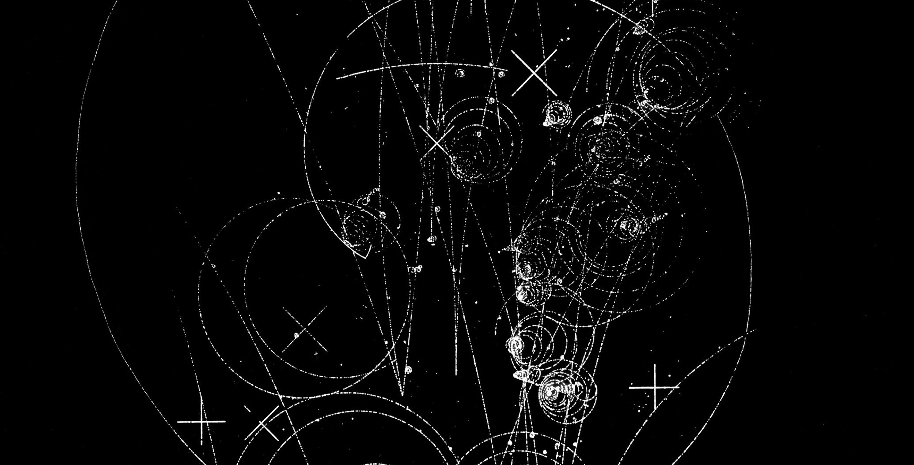
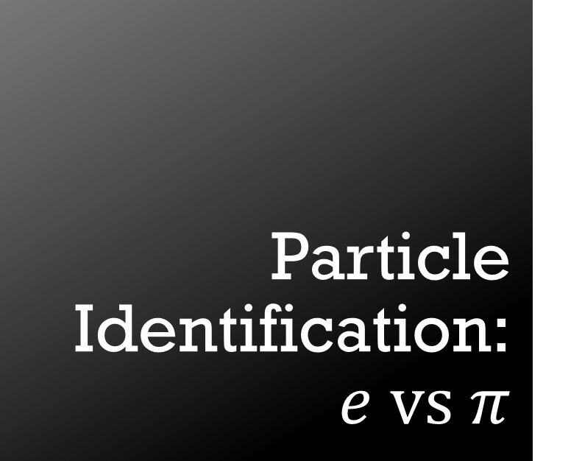
Particle Identification:$e vs π$
USING UNCALIBRATED TRD DIGITS DATA
IMAGES: 17 PADS X 24 TIMEBINS

Slide 5
GEANT4 vs Real Data
Geant4 simulations: pions configured with environmental parameters from LHCq16/000265343
Assessed against real TRD data from pions:
LHCq16/000265343

Slide 6
Deep Generative Models for Fast Detector Simulations
Variational Autoencoders (VAEs)
Generative Adversarial Networks (GANs)
Adversarial Autoencoders (AAEs)

